Slide 1
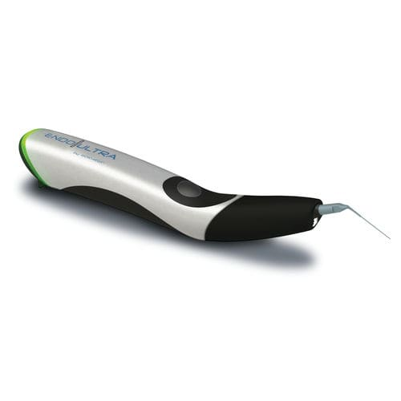
FAQ‘s EndoUltra
A unique and dedicated device
for activation during final rinse.

Slide 2
Table of content
01
Protocol
02
Technology of the tip
03
Life Cycle
04
Safety
05
Comfort
06
Clinical Outcomes

Slide 3
EndoUltra- FAQ
Updates
Time of change | Version | Change
2017, July 6 | A | Initial version
2017, Aug 29 | B | - 5-6 : possibility to curve, uncurve several times the tips thanks to the new design and new material - 9 : impact of new tips’ material
2017, Sept 21 | C | - 6 : restrictions regarding the possibility to unbent the tip - 9 : precisions regarding the impact of new tips’ material
2017, Oct 30 | D | Recommendations regarding the way to locate the working length + the use of the specific wrench to tighten the tip and preserve the battery life
2020, March 2 | E | Due to the information from Audrey the NiTi Tips are reusable up to 20 times max instead of 10 times (slide5)

Slide 4
Protocol
EndoUltra- FAQ
When to use it?
After shaping for disinfection and smear layer removal
How long in the canal?
Sequence of 20-30s then renew the irrigant
How many cycles?
No evidence based but usually 5 cycles are enough for good clinical outcomes
How far from the apex do I have to place the tip?
Max position: WL-1mm, recommended WL: 2-3mm

Slide 5
Technology of the tip
EndoUltra- FAQ
Is the tip reusable?
recommendation is 20 autoclaving sequences max.
Can I bend the tip for a better scouting of canals with difficult access?
Yes, strongly recommended
Why not in NiTi?
NiTi does not drive enough power
Does the tip move?
High frequency so very low amplitude, motion invisible to the naked eye

Slide 6
Technology of the tip
EndoUltra- FAQ
Can we keep the tip straight?
No, the angle that we create using the dedicated tool is required to reach the necessary
and optimal power and to ensure the work in mouth
The angle shall be between 70 and 90°
Tips made in titanium give a complementary margin regarding the angle to be created. If
less than 70° then EndoUltra still remains operational, that was not the case with tips in
stainless steel

Slide 7
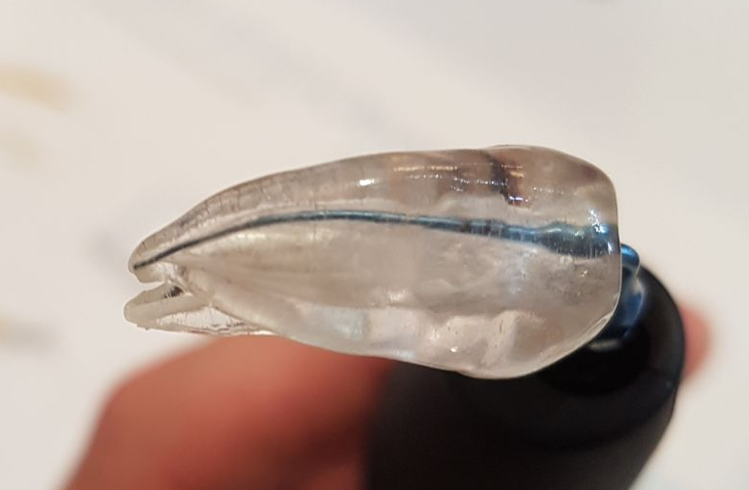
Technology of the tip
EndoUltra- FAQ
Can we unbend the tip and bend it again ?
Titanium tips now replaced stainless steel tips to give more fleibility during use. After
being bent with the required 70-90° angle, changing the angle with the stainless steel TIPS
led to the breakage of the tip. It is no necessarily the case with the Titanium tips, even if
this operation is not recommended, as we can not guarantee resistance and long lasting in
this case, it is not the standard way to use the tip
This new material lets the tips to be slighty bent at the extremity to adapt better to curve
canals
Dr. Rémy BALTHAZARD, France

Slide 8
Technology of the tip
EndoUltra- FAQ
Can I use rubber stoppers for working length ?
Using a rubber stopper is strongly not recommended by the manufacturer. It would absorb ultrasonic waves and as a result, would drastically reduce power then have bad effect on the clinical outcomes. Users should rely on the laser marked depth markers on the tip, placed at 16, 17 and 18mm.
Can I manually tighten the tip ?
The tip should be tightened with the provided wrench. The tip should be snug, it is not needed to tighten hard, no over tightening. Under tightening would reduce the delivered power.

Slide 9
Life Cycle
EndoUltra- FAQ
Battery life cycle?
1,5 hours of continuous work without recharging
To allow battery life to be preserved, it is strongly recommended to proceed to a full
charge cycle before first use
Another recommendation to extend the battery life is to wait for a flat battery (red LED at
the hand-piece) before recharging it

Slide 10
Safety
EndoUltra- FAQ
The tip being metallic, is the EndoUltra safe ?
No continuous physical contact between the canal’s wall and the tip
Passive tip
Smooth structure, rounded tip, no dentin removal (1)
  The clinical effect is based on a physical phenomenon due to the propagation of
  ultrasounds inside a liquid, creating cavitation and acoustic streaming (the
  EndoActivator is based on a different principle where the tip acts as a mecanical
  agitator (electrical mixer))
  No risk of instrument fracture since the power is set for the tip whish has been
  specifically designed for this use, compared to multi-fonctions ultrasounds generators
  which can use different types of tip, depending on the usage
Publications
(1) ”The removal of dentin was slight”
A Micro-CT Assessment of Dentil Removal Following Passive Ultrasonic Irrigation
Medical University of South Carolina, Charleston, SC
V.J. BALL, D.D.S, M.E. LEVITAN, D.D.S, 2016

Slide 11
Comfort
EndoUltra- FAQ
Is it uncomfortable for the patient like scaling of teeth ?
Even if EndoUltra is based on the same technology as teeth scaling devices (ultrasounds),
principles are quite different
Scaling device: desired effect is a physical contact between the tip and the tooth in a dry
environment
  EndoUltra: active effect is due to the propagation of ultrasounds in an aqueous medium, without any physical contact between the tip and the canal’s wall. Tip is limited to a transducer role from the ultrasounds generator and the liquid (irrigant)
The frequency (40kHz) is not audible by human beings

Slide 12
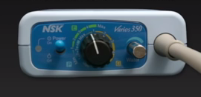
Clinical Outcomes
EndoUltra- FAQ
Why would I use an additional device while I already has a multi-functions ultrasounds generator (scaling…) ?
The EndoUltra is a dedicated device for activation ONLY, to be used after the shaping. It
has been specifically designed for that purpose, always at your fingertips, and does not
require any specific settings. Frequency is pre-set, you only have to switch on. The tip has
to be bent to easily access to posterior teeth and taper is adapted to the final taper of the
canal after shaping
A multi-function ultrasounds generator requires the right power to be set before use, and
adapt the tip itself. Setting too much power may damage the tooth structure

Slide 13
Clinical Outcomes
EndoUltra- FAQ
Is EndoUltra as much efficient as the EndoActivator ?
These 2 devices are not based on the same technologies and clinical results are not the same
Scientific and clinical studies proves better outcomes with the EndoUltra
Publications
“Of the adjonction irrigant activators, the EndoUltra opened 94%, 117% and 26% more tubules in the apex, middle, and coronal thirds respectively, than the EndoActivator”, “The EndoUltra cleaned canals more effectively than the EndoActivator and conventional irrigators”
Alex Johnson, Msc, Joh Baeten, Msc, Dr. Upendra Hoshing, 2017
4. “Endoultra ultrasonic activation of 3% NaOCl produces lower bacteria count and turbidity after treatment and after reincubation of 24 hours than sonic or no activation”
Dr. Eugenio Pedullà, 2016
Immediate and residual antimicrobial efficacy of irrigants activated by cordless sonic or ultrasonic devices: an ex-vivo study

Slide 14
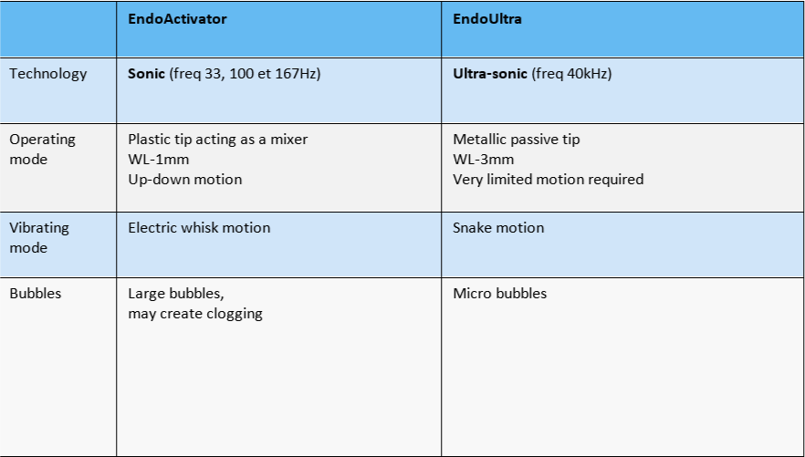
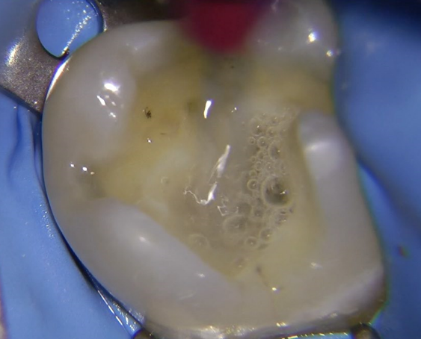
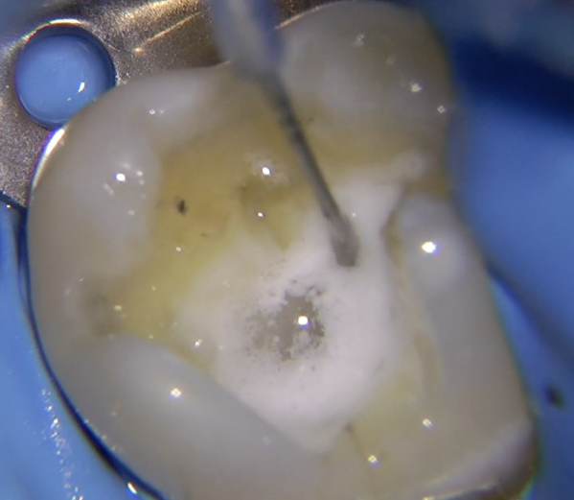
Clinical Outcomes
EndoUltra- FAQ

